Slide 2
Extracorporeal or Systemic assistance
And Perfomance

Slide 3
Objectivies
Understanding the Extracorporeal performance and assistance section
Understand the Extracorporeal performance and assistance section Specific Guideline & Coding Tips
Clinical examples for better understanding
Knowledge Check

Slide 4
Definition
There are 3 root operation in this Section
Assistance: Taking Over a portion of a Physiological function by Extracorporeaal means
Perfomance: Completely taking Over a Physiological function by Extracorporeaal means
Restoration: Returning, or attempting to return a physiological function to a natural state by extracorporeal means.

Slide 5
Coding Tip
This section has a 1st character value as 5
The Second character value is A (i.e) Physiological System
Third charchter is Root operation either Assistance, Perfomance, Restorationprocedure
The root operation restoration contains Single procedure code that identifies extracorporeal cardioversion
The Fouth Charcter denotes the body where it is performed
The fifth character denotes duration of procedure
Sixth charcter denotes the physiological function assisted or performed Eg( Oxygenation, Ventilation) during procedure
Seventh Charcater denotes type of equipement used if any

Slide 6
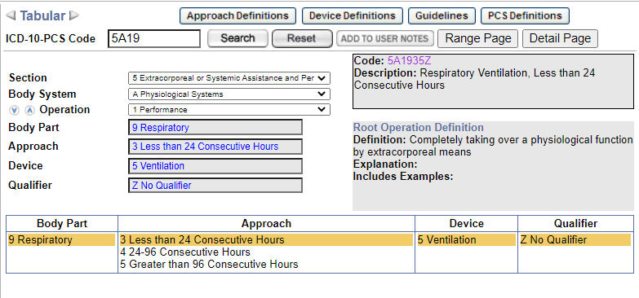
Clinical Examples
Intermittent mechanical Ventilation , 16 hrs?
ANS: 5A1935Z

Slide 7
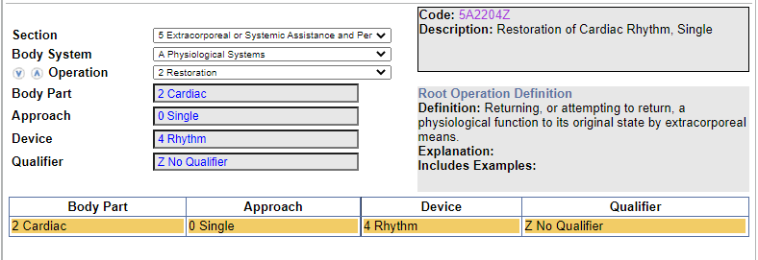
Clinical Example
Cardiac countershock with successful conversion to sinus rhythm?
ANS:5A2204Z

Slide 8
Knowledge check
Intra aortic balloon pump (IABP) continuous?
Controlled Mecahnical Ventillation (CMV) 45 hrs?
IPPB (Intermittent positive pressure breathing) for mobilization of secretion 22hrs?
Ans :??????

Slide 9
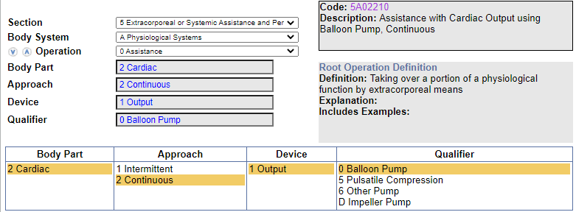
ANS: 5A02210, 5A1945Z,
5A09358

Slide 10
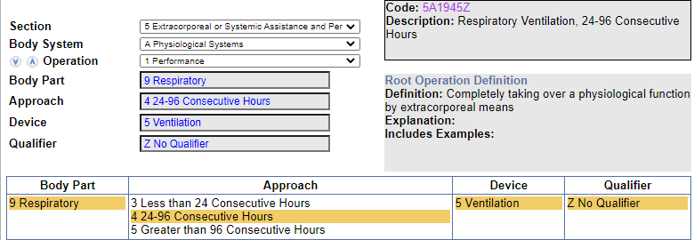
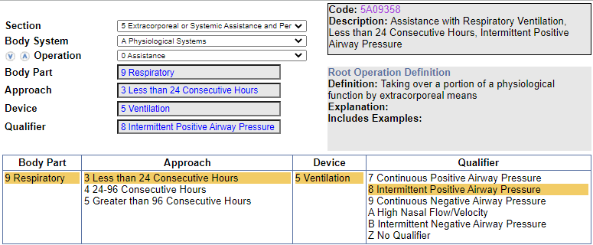

Slide 11
THANK YOU

